Slide 1

Stereo Matching Based on Convolutional neural network
Stereo Matching based on Convolutional Neural Network
12171016 Xiao Huang
Instructor： Shiping Zhu

Slide 2
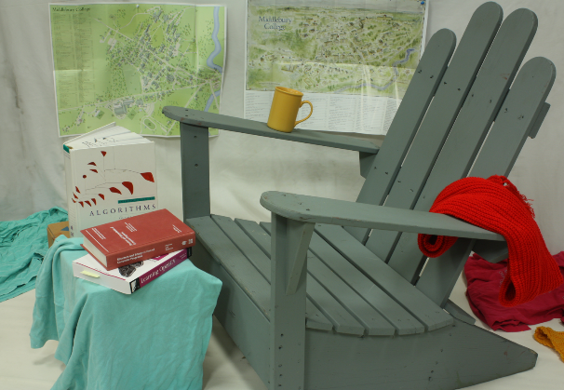
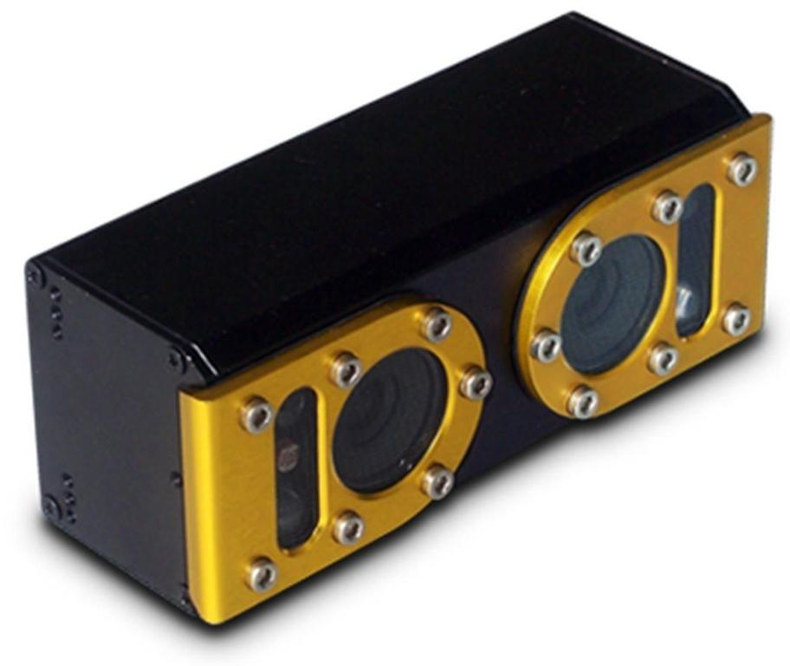
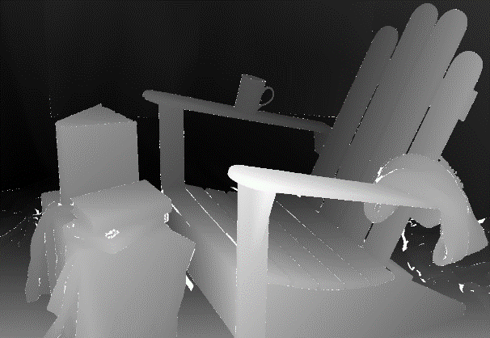
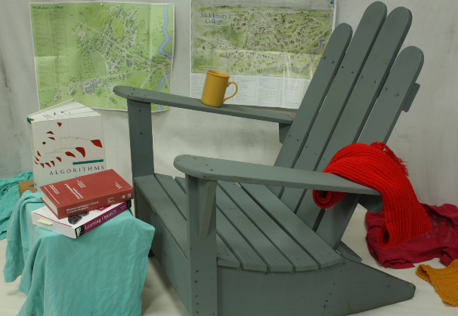
Stereo Matching Based on Convolutional neural network
Stereo Matching
Using left and right images taken by Stereo Cameras，find corresponding matching points on both left and right images.
The disparity is the horizontal difference between a pair of matching points on left and right images
Based on disparity information we can calculate depth information of the image.
Left Image
Stereo Matching
Right Image
Disparity Map
Stereo Camera

Slide 3
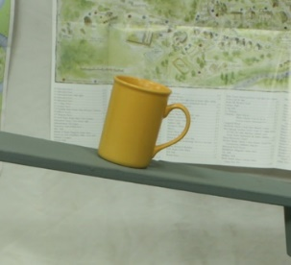
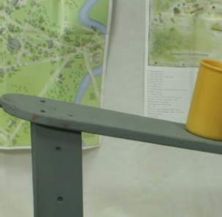
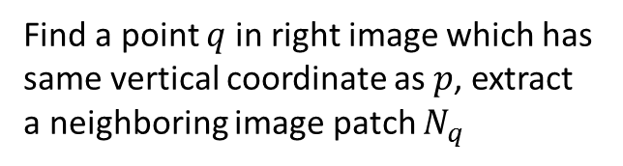
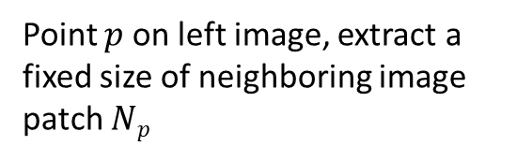
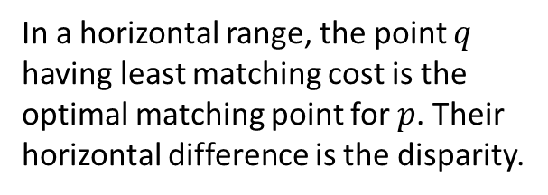
Stereo Matching Based on Convolutional neural network
Based on global image
Based on features
Based on local regions
Stereo Algorithm
Algorithm based on local regions is more accurate and efficient and it is currently most popular method.
Point $p$ on left image, extract a fixed size of neighboring image patch $Np$
Define a similarity measurement function
Matching cost of two image patches
In a horizontal range, the point $q$ having least matching cost is the optimal matching point for $p$. Their horizontal difference is the disparity.
Find a point $q$ in right image which has same vertical coordinate as $p$, extract a neighboring image patch $N_{q}$

Slide 4
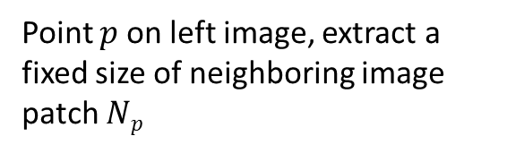
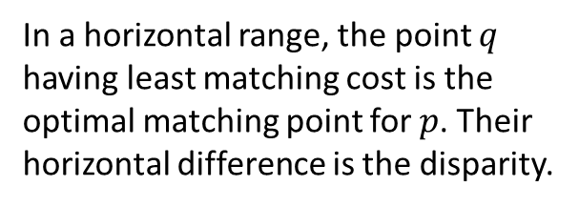
Stereo Matching Based on Convolutional neural network
Matching algorithm based on deep learning
Auto-Encoder
DBN
Unsupervised
Convolutional neural network is the most successful model in deep learning currently
Deep Learning
Supervised
CNN
Based on previous regional matching algorithm, now we can replace similarity measurement function with CNN. After the CNN has been trained for a large amount of training data, using CNN to compute matching cost is more accurate than the similarity measurement function which is artificially defined.
Point $p$ on left image, extract a fixed size of neighboring image patch $Np$
Matching cost of two image patches
Define a similarity measurement function
Convolution Neural Network
In a horizontal range, the point $q$ having least matching cost is the optimal matching point for $p$. Their horizontal difference is the disparity.
Find a point $q$ in right image which has same vertical coordinate as $p$, extract a neighboring image patch $N_{q}$

Slide 5
Stereo Matching Based on Convolutional neural network
Convolutional Neural Network with different structures
Accurate Architecture
Fast Accurate
Similarity Score
Add negative sign
Matching Cost
Linear Layer+Sigmoid
Similarity Score
Add negative sign
Matching Cost
Linear Layer+ReLU
Normalize, take dot product
Linear Layer+ReLU
convert to vector
Convolution Layer
Convolution Layer
Convolution Layer+ReLU
Convolution Layer+ReLU
Convolution Layer+ReLU
Convolution Layer+ReLU
Convolution Layer+ReLU
Convolution Layer+ReLU
Convolution Layer+ReLU
Convolution Layer+ReLU
Convolution Layer+ReLU
Convolution Layer+ReLU
Convolution Layer+ReLU
Convolution Layer+ReLU
Left Image Patch N_{p}
Right Image Patch N_{q}
Left Image Patch N_{p}
Right Image Patch N_{q}

Slide 6
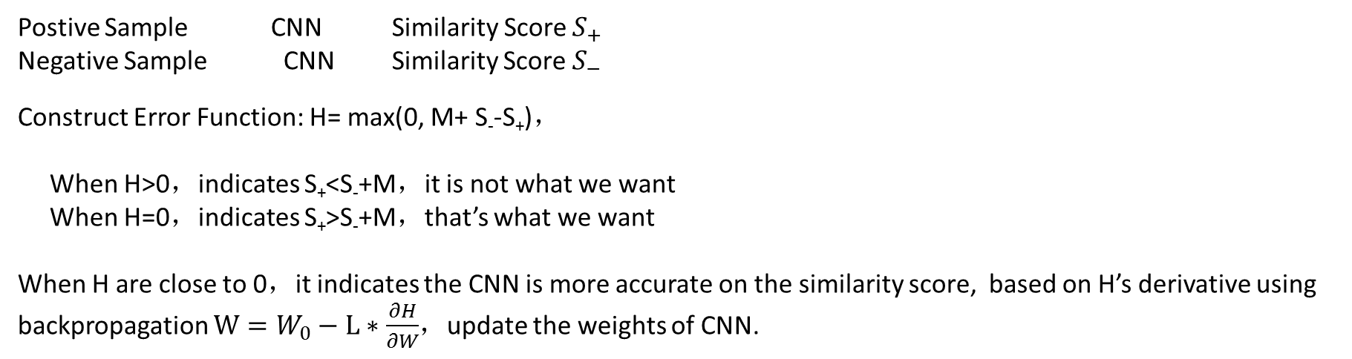
Stereo Matching Based on Convolutional neural network
How CNN calculate the similarity score
Middlebury training datasets provides accurate ground truth for disparities
According to accurate disparity, extract correct matching points with their neighboring image patches. They are positive samples.
According to false disparity, extract worng matching points with their neighboring image patches. They are negative samples.
Postive Sample CNN Similarity Score $S_{+}$
Negative Sample CNN Similarity Score $S_{−}$
Construct Error Function: H= max(0, M+ S₋-S₊)，
When H>0，indicates S₊<S₋+M，it is not what we want
When H=0，indicates S₊>S₋+M，that’s what we want
When H are close to 0，it indicates the CNN is more accurate on the similarity score, based on H’s derivative using backpropagation $W=W_{0}−L∗\frac{∂H}{∂W}$，update the weights of CNN.

Slide 7
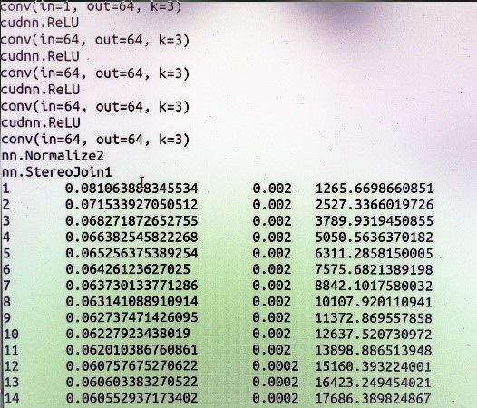
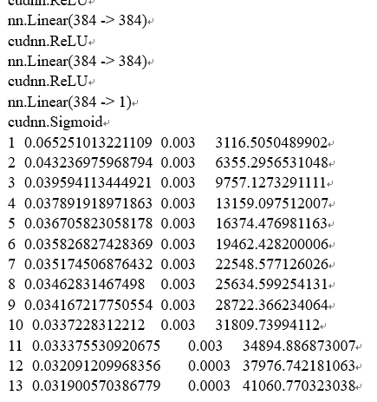
Stereo Matching Based on Convolutional neural network
Training Convolution Neural Network
Middlebury 2003-2014 Stereo Images as training images：
Fast Architecture，cost 5 hours totally，final error is 0.06
Accurate Architecture，cost 14 hours totally，final error is 0.03

Slide 8
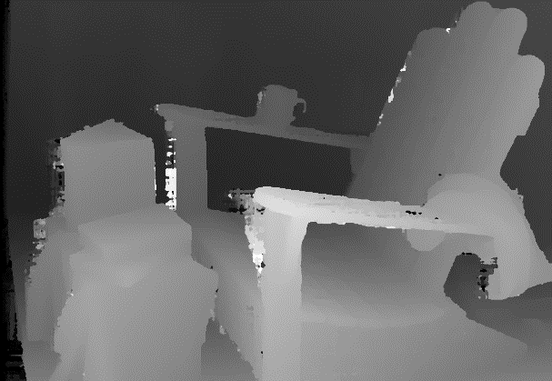
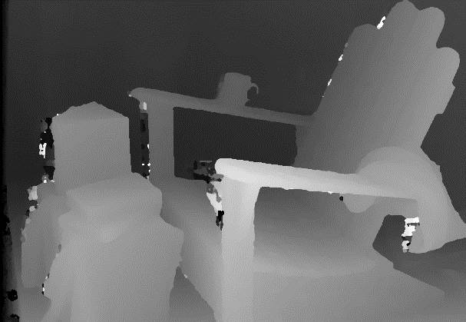
Stereo Matching Based on Convolutional neural network
Fast Architecture V.S. Accurate Architecture
Comparison of Disparity Map：
Fast Architecture
Accurate Architecture

Slide 9
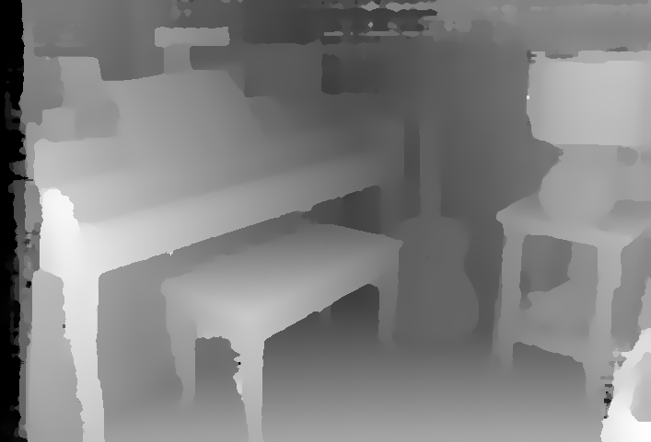
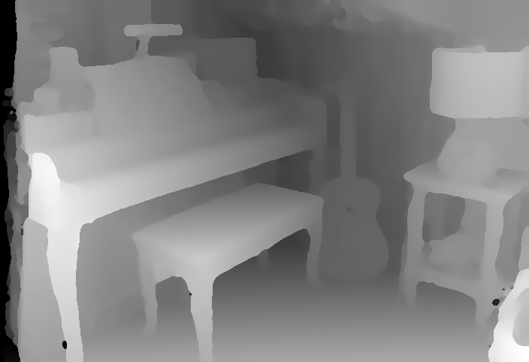
Stereo Matching Based on Convolutional neural network
Fast Architecture V.S. Accurate Architecture
Accurate has better quality, low noise and smooth contours.
Fast Architecture
Accurate Architecture

Slide 10
Stereo Matching Based on Convolutional neural network
Fast Architecture V.S. Accurate Architecture
Error Comparison：
 | Avg error | Adiron | ArtL | Jade | Motor | MotorE | Piano | PianoL | Pipes | Playroom | Playtable | PlaytableP | Recycle | Shelves | Teddy | Vintage
Fast | 11.9 | 5.15 | 9.13 | 16.7 | 4.71 | 4.58 | 16.6 | 24.0 | 6.20 | 18.4 | 18.0 | 12.6 | 8.13 | 33.5 | 4.92 | 25.5
Accu | 10.3 | 3.33 | 8.04 | 16.1 | 3.66 | 3.76 | 12.5 | 18.5 | 4.22 | 14.6 | 15.1 | 13.3 | 6.92 | 30.5 | 4.65 | 24.8

Slide 11
Stereo Matching Based on Convolutional neural network
Fast Architecture V.S. Accurate Architecture
Comparison of efficiency：
 | Avg time（s） | Adirondack | ArtL | Jadeplant | Motorycle | Piano | Pipes | Playroom | Playtable | Recycle | Shelves | Teddy | Vintage
Fast | 3.26 | 3.42 | 2.32 | 4.18 | 3.33 | 3.16 | 3.34 | 3.35 | 3.16 | 3.18 | 3.18 | 2.56 | 4.64
Accu | 106 | 100 | 23.9 | 206 | 109 | 99 | 108 | 122 | 104 | 92.6 | 94.5 | 40.5 | 264

Slide 12
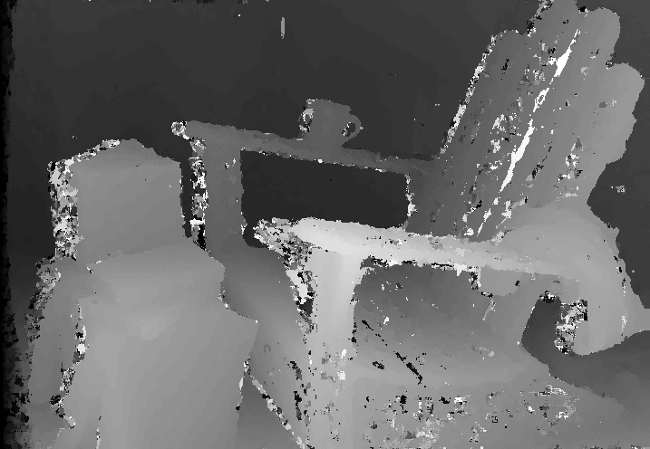
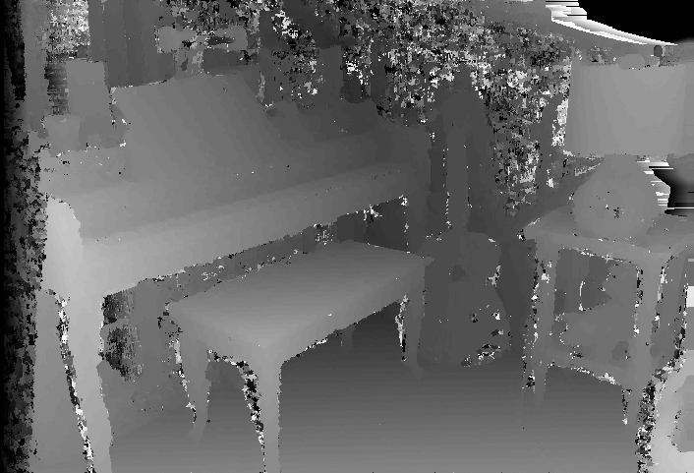
Stereo Matching Based on Convolutional neural network
Classical Stereo Optimization Method
Stereo optimization can further improve the quality of disparity map
Cross-based matching cost aggregation
Energy minimization
Left-right disparity map consistency
Sub-pixel improvements
Bilateral filter/Median filter

Slide 13


Stereo Matching Based on Convolutional neural network
Improvements on edge location and low texture location
There still exist several problems in the disparity map calculated by CNN
The edge region and low texture region of the disparity map have large error

Slide 14
Stereo Matching Based on Convolutional neural network
Further improvement algorithm for Disparity Map
Inspired by Cross-based matching cost aggregation, I suggest a new algorithm for improving the accuracy of edge region and low texture region of disparity map. ：
1. Based on cross-based growth, set threshold for growth and perform both vertical and horizontal growth to get a neighboring growth region for every point of the disparity image.
2. Based on neighboring growth region, build a disparity histogram for this region.
3. Based on disparity histogram, select the disparity with highest frequency to replace the disparity of original point.
4. For every point on disparity map, repeat step 1,2,3 until we update the whole disparity map.

Slide 15


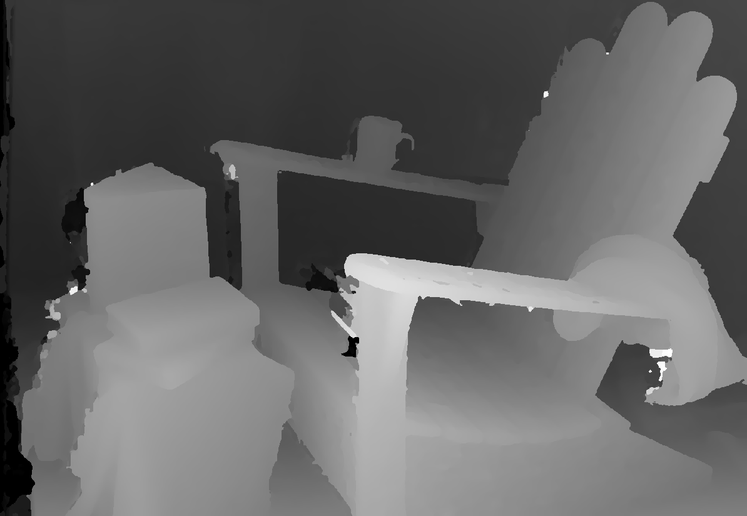
Stereo Matching Based on Convolutional neural network
The performance of the new improvement method
Results after classical optimization algorithms
Using my new algorithm to further improve the result

Slide 16
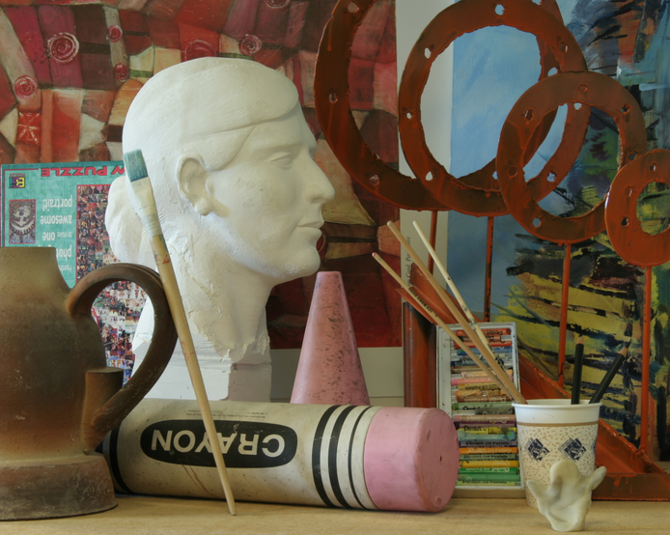
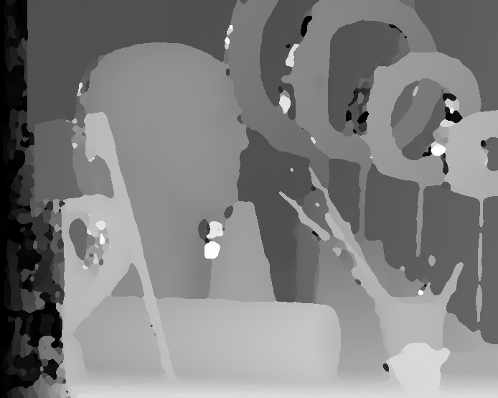
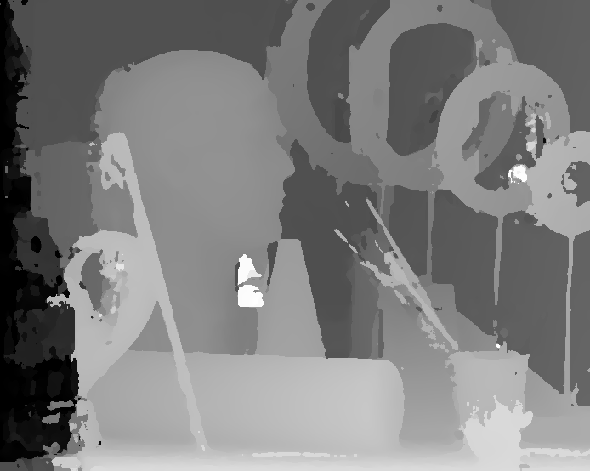
Stereo Matching Based on Convolutional neural network
The performance of the new improvement method
Results after classical optimization algorithms
Using my new algorithm to further improve the result

Slide 17

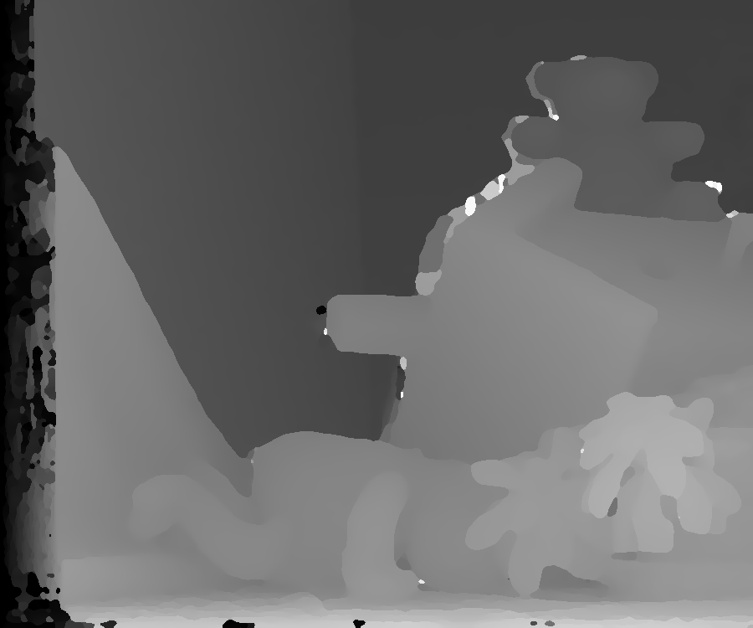
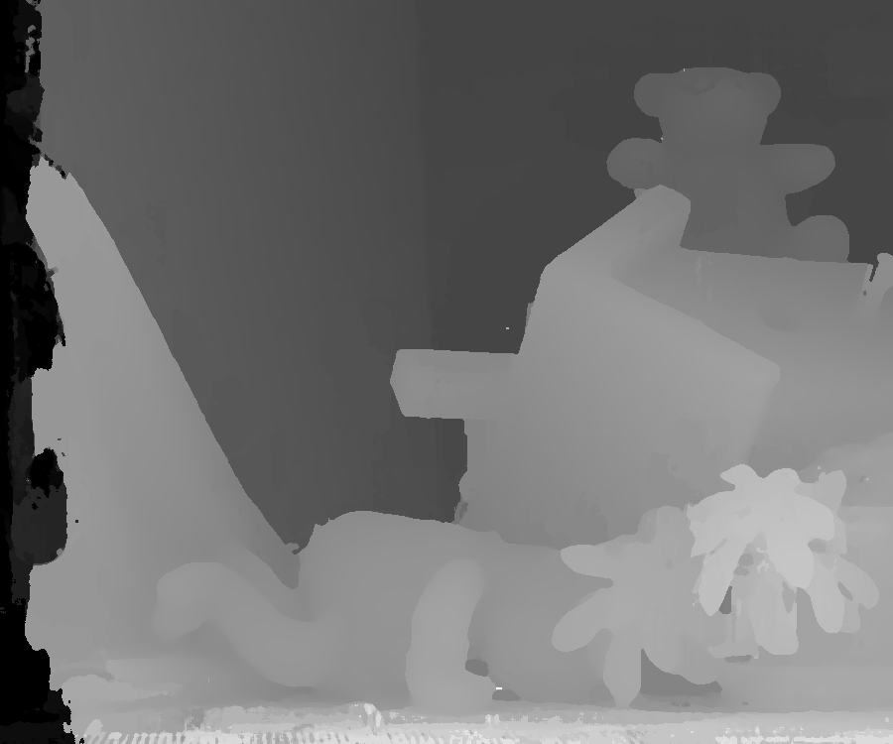
Stereo Matching Based on Convolutional neural network
The performance of the new improvement method
Results after classical optimization algorithms
Using my new algorithm to further improve the result

Slide 18
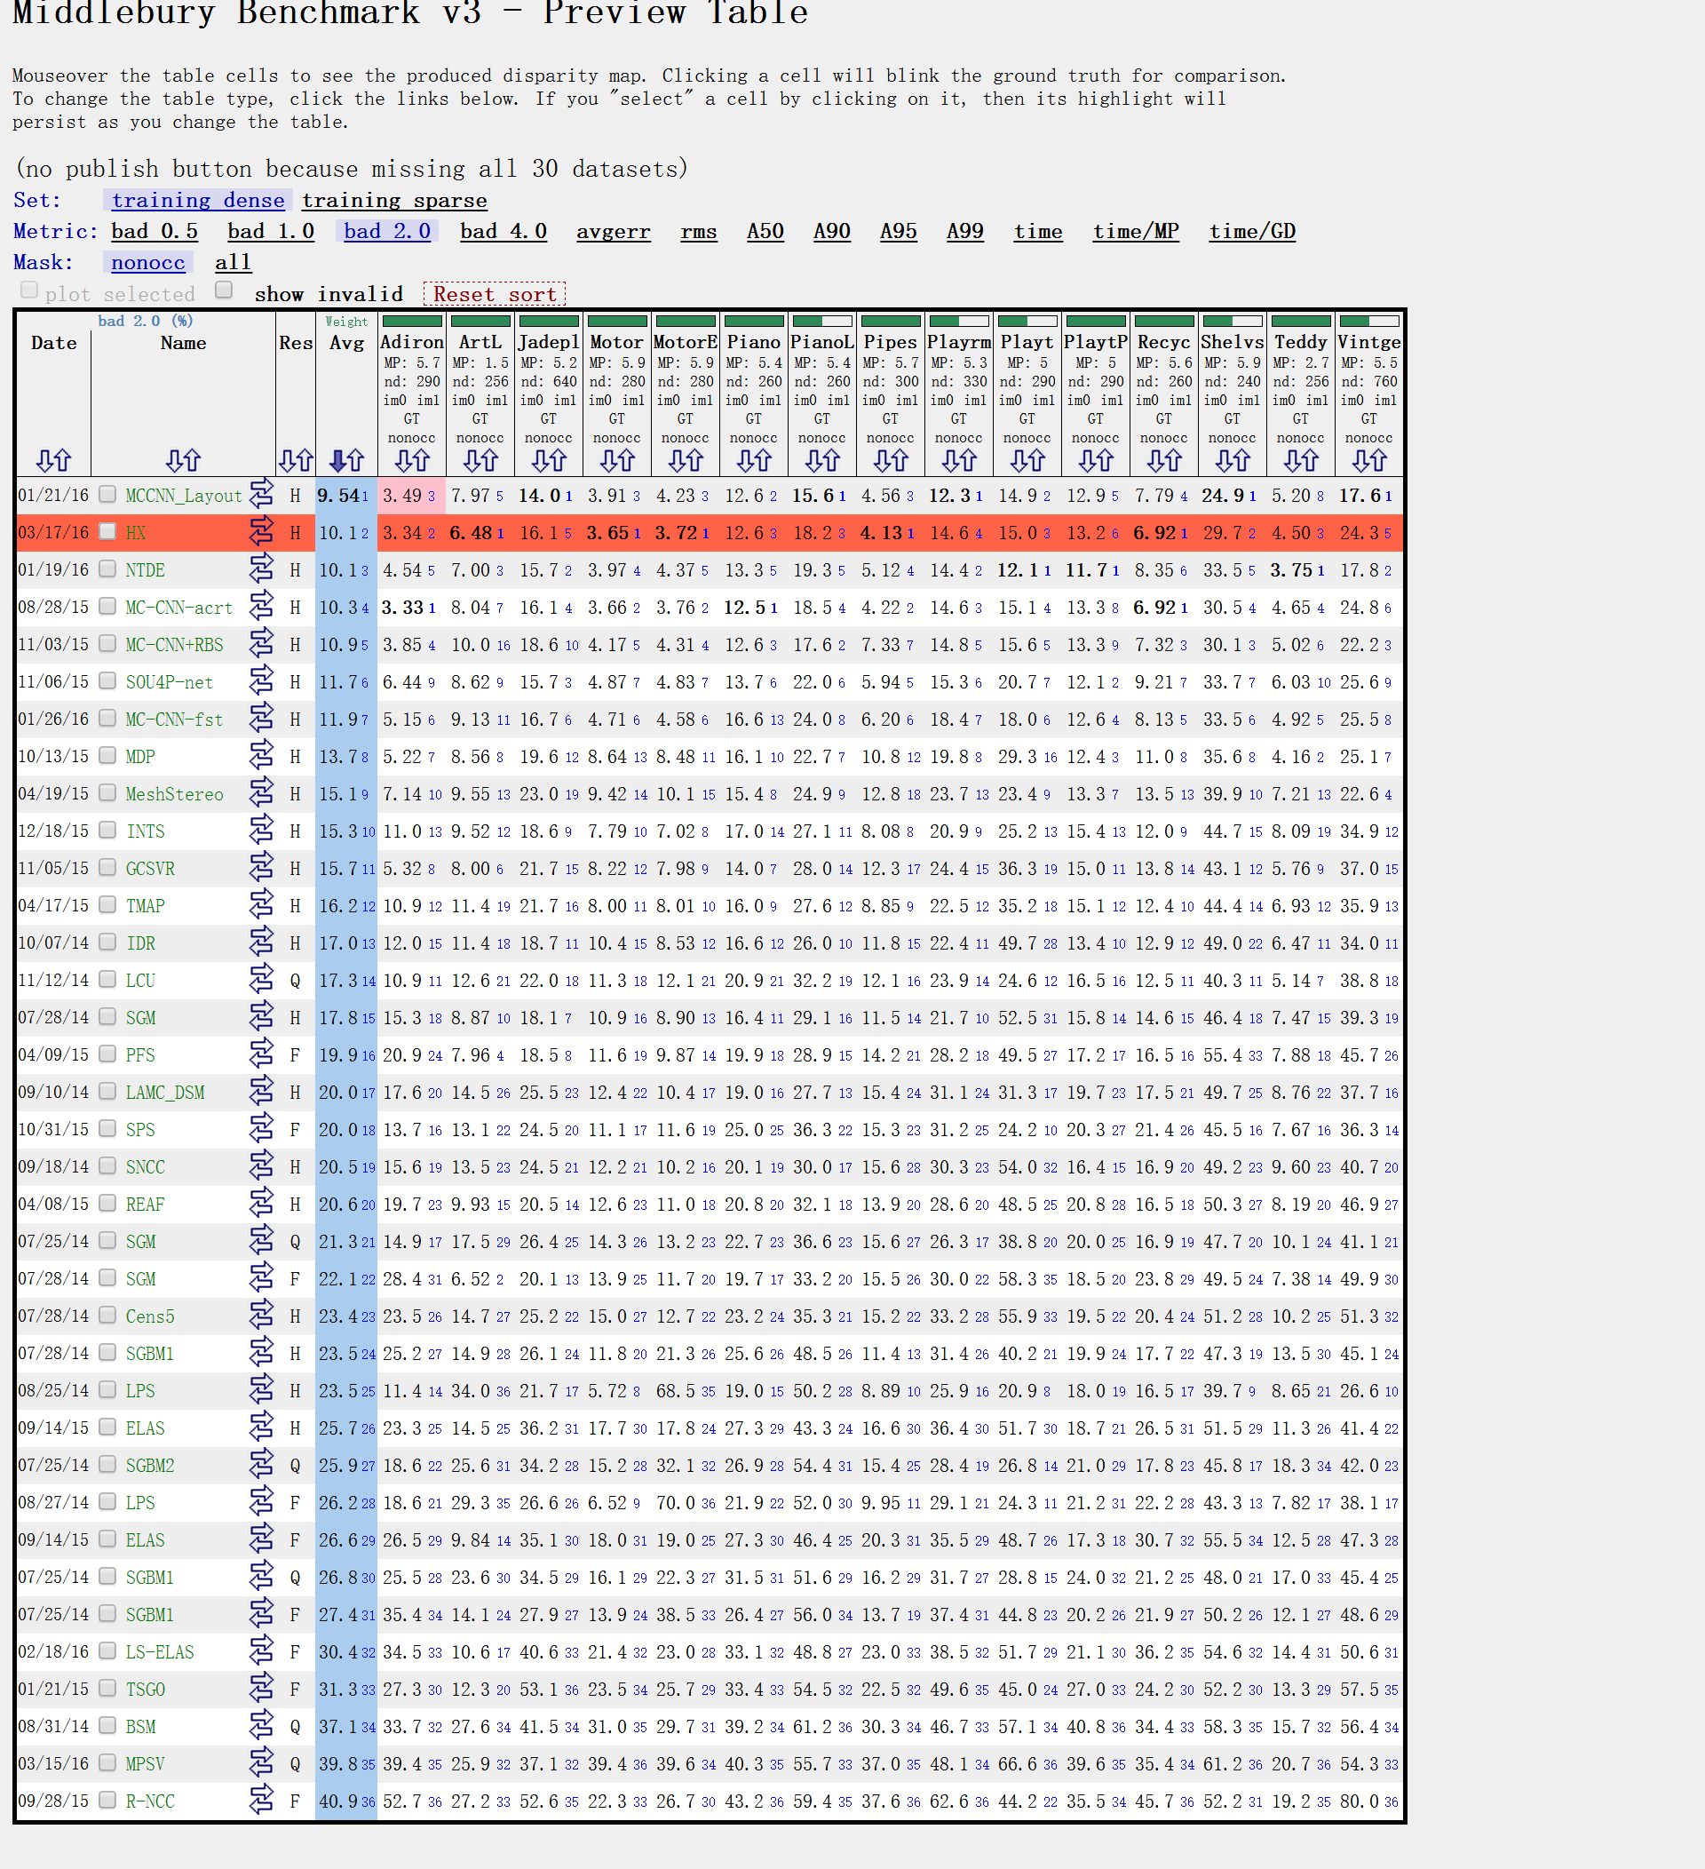
Stereo Matching Based on Convolutional neural network
The performance of the new improvement method
Improvements of the new algorithm：
 | Avg error | Adiron | ArtL | Jade | Motor | MotorE | Piano | PianoL | Pipes | Playroom | Playtable | PlaytableP | Recycle | Shelves | Teddy | Vintage
After | 10.1 | 3.34 | 6.48 | 16.1 | 3.65 | 3.72 | 12.6 | 18.2 | 4.13 | 14.6 | 15.0 | 13.2 | 6.92 | 29.7 | 4.50 | 24.3
Before | 10.3 | 3.33 | 8.04 | 16.1 | 3.66 | 3.76 | 12.5 | 18.5 | 4.22 | 14.6 | 15.1 | 13.3 | 6.92 | 30.5 | 4.65 | 24.8
Based on original result, using the new improvements algorithm I suggest in this project successfully increase the final accuracy of the disparity map. The accuracy of edge region has been largely improved, the contour of objects in the disparity map become more smooth and clear. Overall, the new algorithm help lower the average error for 0.2 percent. 。

Slide 19
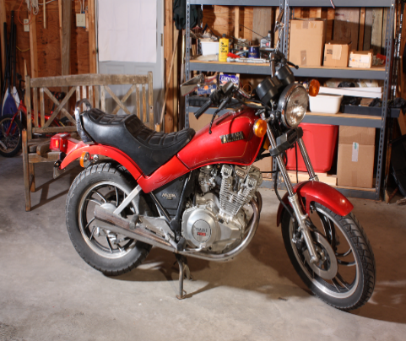
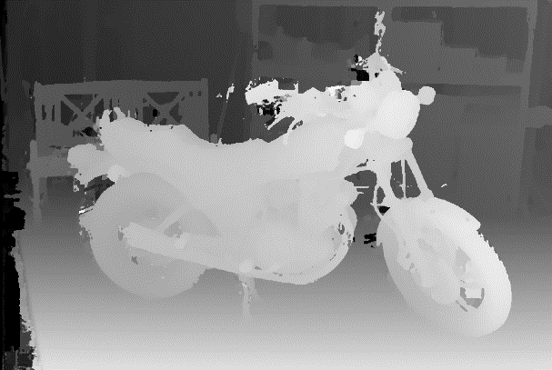
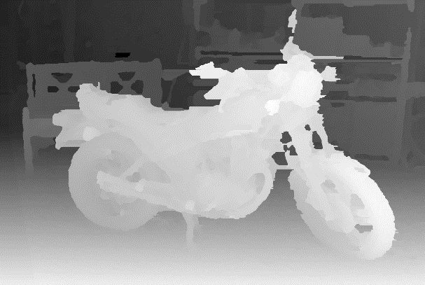
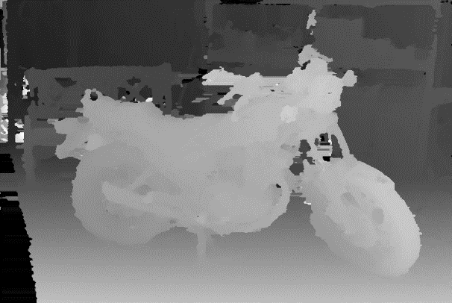
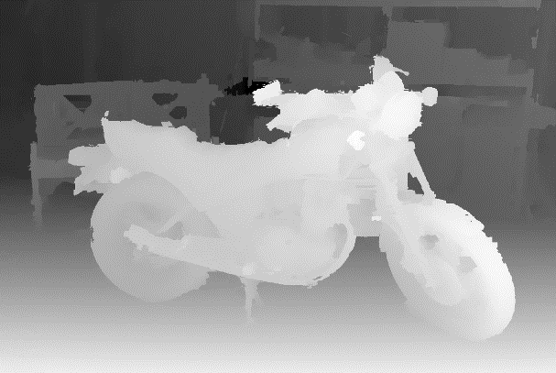
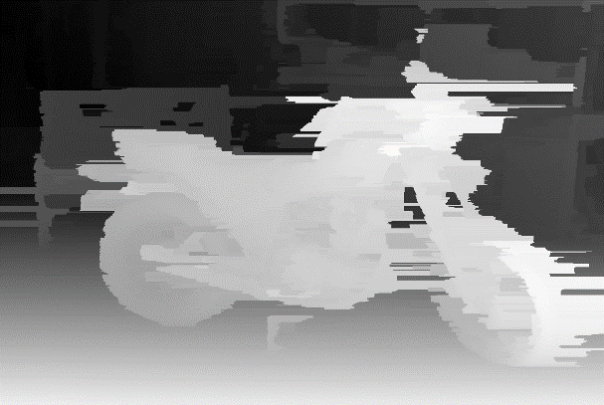
Stereo Matching Based on Convolutional neural network
CNN based method V.S. Previous method
Previous methods include Census，Semi-global Block Matching, MeshStereo and NCC。
Disparity Map Comparison：
Original Image | CNN | Census | SGM | MeshStereo | NCC
CNN based stereo matching have best visual result.

Slide 20
Stereo Matching Based on Convolutional neural network
CNN based method V.S. Previous method
Error Comparison：
 | Avg error | Adiron | ArtL | Jade | Motor | MotorE | Piano | PianoL | Pipes | Playroom | Playtable | PlaytableP | Recycle | Shelves | Teddy | Vintage
CNN(Accurate Arch) | 10.1 | 3.34 | 6.48 | 16.1 | 3.65 | 3.72 | 12.6 | 18.2 | 4.13 | 14.6 | 15.0 | 13.2 | 6.92 | 29.7 | 4.50 | 24.3
MeshStere | 15.1 | 7.14 | 9.55 | 23.0 | 9.42 | 10.1 | 15.4 | 24.9 | 12.8 | 23.7 | 23.4 | 13.3 | 13.5 | 39.9 | 7.21 | 22.6
Census | 23.4 | 23.5 | 14.7 | 25.2 | 15.0 | 12.7 | 23.2 | 35.3 | 15.2 | 33.2 | 55.9 | 19.5 | 20.4 | 51.2 | 10.2 | 51.3
SGBM | 23.5 | 25.2 | 14.9 | 26.1 | 11.8 | 21.3 | 25.6 | 48.5 | 11.4 | 31.4 | 40.2 | 19.9 | 17.7 | 47.3 | 13.5 | 45.1
NCC | 40.9 | 52.7 | 27.2 | 52.6 | 22.3 | 26.7 | 43.2 | 59.4 | 37.6 | 62.6 | 44.2 | 35.5 | 45.7 | 52.2 | 19.2 | 80.0

Slide 21
Stereo Matching Based on Convolutional neural network
CNN based method V.S. Previous method
Efficiency Comparison：
 | Avg time(s) | Adiron | ArtL | Jade | Motor | MotorE | Piano | PianoL | Pipes | Playroom | Playtable | PlaytableP | Recycle | Shelves | Teddy | Vintage
CNN(Accurate Arch) | 3.26 | 3.42 | 2.32 | 4.18 | 3.33 | 3.16 | 3.34 | 3.26 | 3.35 | 3.16 | 3.18 | 3.18 | 2.56 | 4.64 | 3.35 | 3.16
MeshStere | 62.0 | 59.1 | 49.8 | 87.0 | 63.0 | 63.0 | 62.2 | 62.5 | 66.6 | 66.2 | 58.4 | 57.9 | 56.9 | 59.5 | 50.4 | 71.5
Census | 1.34 | 1.44 | 0.31 | 2.36 | 1.37 | 1.37 | 1.26 | 1.26 | 1.44 | 1.44 | 1.28 | 1.27 | 1.30 | 1.25 | 0.58 | 2.97
SGBM | 0.18 | 0.22 | 0.04 | 0.29 | 0.19 | 0.19 | 0.17 | 0.17 | 0.18 | 0.20 | 0.16 | 0.16 | 0.18 | 0.17 | 0.08 | 0.36
NCC | 5883 | 4620 | 1080 | 9999 | 9999 | 4560 | 3960 | 3660 | 4740 | 9999 | 9999 | 3720 | 9999 | 7620 | 1080 | 8280

Slide 22

Thanks for Your Guidance
Xiao Huang 12171016

